Slide 1
Class 4: Deep and Convolutional Neural Networks

Slide 2
Outline
Introduce new layer types: dropout, normalisation, pooling
1D convolution: intuition and examples
2D convolution and kernels
Building deep CNNs & applications
Regularisation, extensions & outlook
[3] [4]

Slide 3

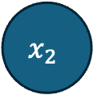
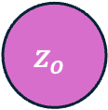
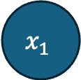
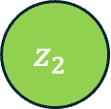
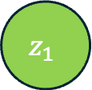

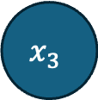

Dense networks: recap
$$x_{1}$$
Each neuron computes a weighted sum of all inputs, adds a bias, and applies a non‑linearity (e.g. ReLU).
Dense layers are fully connected: every input connects to every output, leading to many parameters.
Parameter count grows quickly with input dimension
$$h_{1}=ReLU(z_{1})$$
$$z_{1}$$
$$x_{2}$$
$$z_{o}$$
$$z_{2}$$
$$\hat{y}=σ(z_{o})$$
$$x_{3}$$
$$h_{2}=ReLU(z_{2})$$

Slide 4
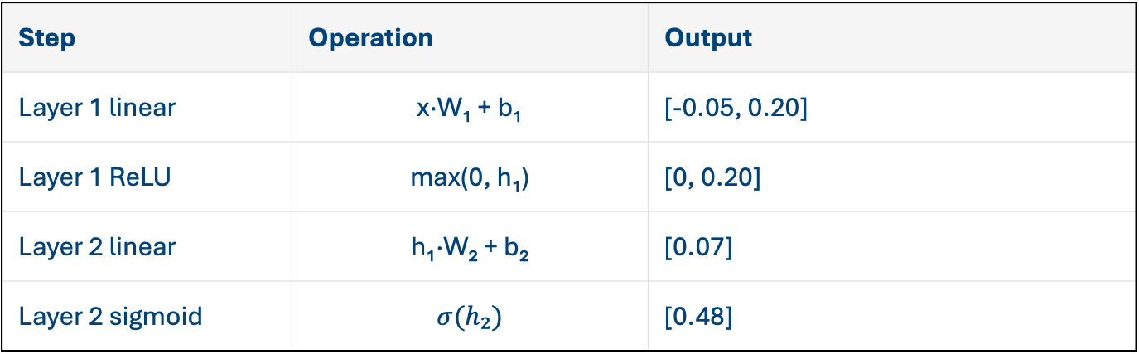
Dense network forward example
Step | Operation | Output
Layer 1 linear | x·W₁ + b₁ | [-0.05, 0.20]
Layer 1 ReLU | max(0, h₁) | [0, 0.20]
Layer 2 linear | h₁·W₂ + b₂ | [0.07]
Layer 2 sigmoid | $$σ(h₂)$$ | [0.48]
Example input: x = [1, 0.5, -1] Weights W₁ (3×2) and W₂ (2×1) chosen for illustration. Biases are zeros for simplicity.
The computation proceeds layer by layer: linear combination followed by ReLU to produce non‑negative activations.

Slide 5
New neural network layers
We have already met ReLU, sigmoid, and tanh activation functions, but there are many other ways to play with hidden neurons.
Dropout: randomly deactivate neurons during training to prevent over‑fitting and scale survivors to keep expectations.
Batch normalisation: normalise activations to zero mean and unit variance, then scale and shift with learnable parameters.
Pooling: downsample feature maps using max or average operations to summarise local regions and introduce invariance (most useful for convolutions – later in class).

Slide 6
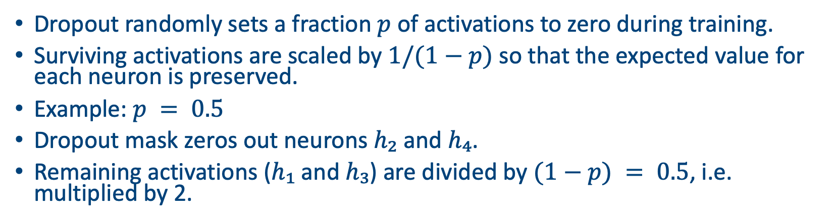
Dropout example
Dropout randomly sets a fraction $p$ of activations to zero during training.
Surviving activations are scaled by $1/(1−p)$ so that the expected value for each neuron is preserved.
Example: $p = 0.5$
Dropout mask zeros out neurons $h₂$ and $h₄$.
Remaining activations ($h₁$ and $h₃$) are divided by $(1−p) = 0.5$, i.e. multiplied by 2.
Neuron | Original | Mask | Scaled output
h₁ | 0.50 | 1 | 1.00
h₂ | -1.00 | 0 | 0.00
h₃ | 2.00 | 1 | 4.00
h₄ | 1.00 | 0 | 0.00

Slide 7
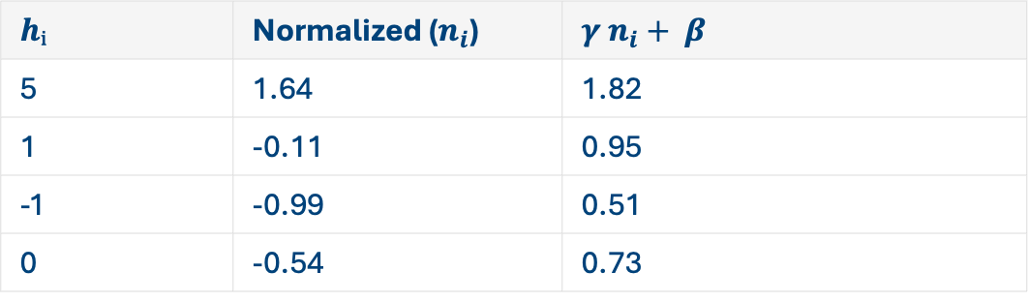
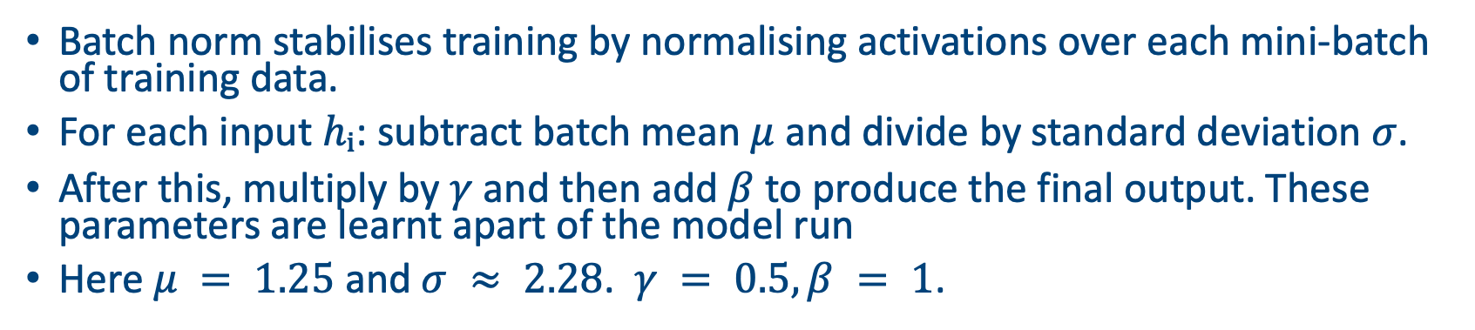
Batch normalization example
Batch norm stabilises training by normalising activations over each mini‑batch of training data.
For each input $hᵢ$: subtract batch mean $μ$ and divide by standard deviation $σ$.
After this, multiply by $γ$ and then add $β$ to produce the final output. These parameters are learnt apart of the model run
Here $μ = 1.25$ and $σ ≈ 2.28$. $γ = 0.5, β = 1$.
$$hᵢ$$ | Normalized ($n_{i}$) | $$γ n_{i}+ β$$
5 | 1.64 | 1.82
1 | -0.11 | 0.95
-1 | -0.99 | 0.51
0 | -0.54 | 0.73

Slide 8
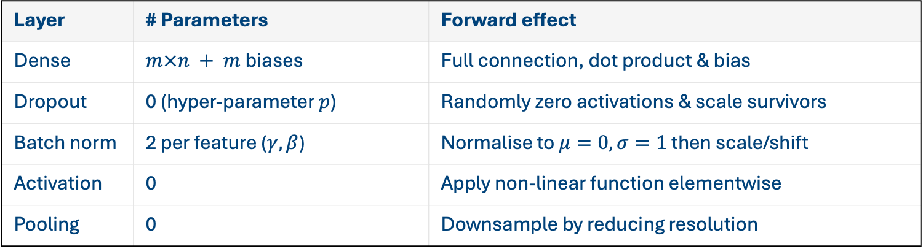
Layer types
This table summarises the roles of each layer type, the number of learnable parameters they add, and how they transform activations during the forward pass.
Layer | # Parameters | Forward effect
Dense | $m×n + m$biases | Full connection, dot product & bias
Dropout | 0 (hyper‑parameter $p$) | Randomly zero activations & scale survivors
Batch norm | 2 per feature ($γ, β$) | Normalise to $μ=0, σ=1$ then scale/shift
Activation | 0 | Apply non‑linear function elementwise
Pooling | 0 | Downsample by reducing resolution

Slide 9
Convolutional layers

Slide 10
Introduction to Convolutional NNs
Most commonly (but not exclusively) used when the inputs are rectangular
e.g. spatial data, satellite images, sound files
Interested in the relationship between the ‘pixels’ in the image
Try to extract interesting features

Slide 11
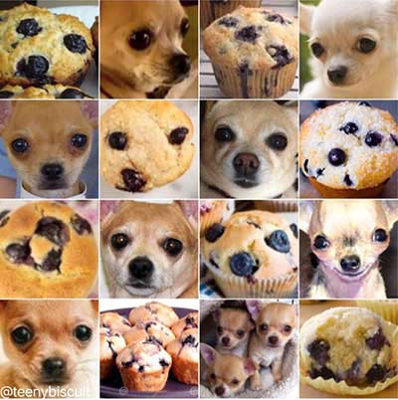
Uses
Image classification: recognise objects in photos (e.g. muffins vs. dogs).
Object detection: locate bounding boxes and labels in scenes.
Semantic segmentation: assign a class to every pixel.
Audio and speech: 1D convolutions process waveforms for speech recognition.
Time series & natural language: sequence models combine convolutions with recurrent layers or transformers.

Slide 12
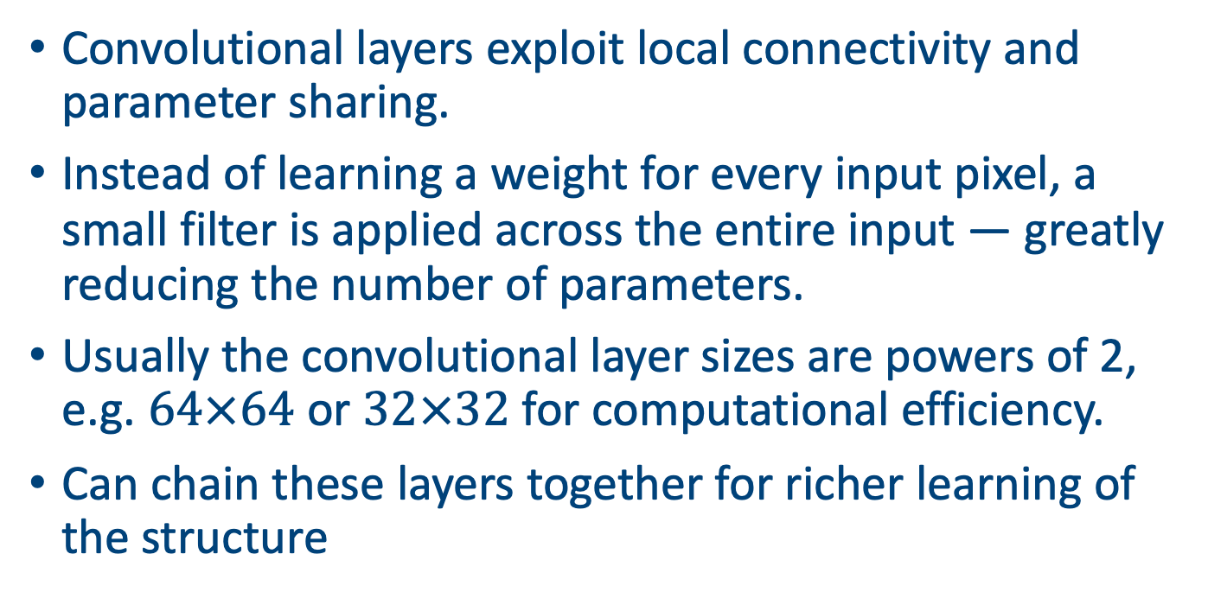
Why convolutional layers?
Convolutional layers exploit local connectivity and parameter sharing.
Instead of learning a weight for every input pixel, a small filter is applied across the entire input — greatly reducing the number of parameters.
Usually the convolutional layer sizes are powers of 2, e.g. $64×64$ or $32×32$ for computational efficiency.
Can chain these layers together for richer learning of the structure

Slide 13
A 1D convolutional layer example
A 1D convolution slides a small filter over a 1D signal.
At each position the dot product between the filter and the current window of the signal is computed, producing a new feature.
This operation introduces locality and parameter sharing — the same filter is reused across positions.
Input
1
2
3
2
1
Kernel
1
0
-1

Slide 14
1D convolutional layer example (cont)
Example: input x = [2, 0, 3, 1, −1], filter w = [1, 0, −1], stride = 1, no padding.
The filter slides across the signal and computes a dot product at each position.
Output sequence: [−1, −1, 4]
Position | Window | Dot product
1 | [2, 0, 3] | 2×1 + 0×0 + 3×(−1) = −1
2 | [0, 3, 1] | 0×1 + 3×0 + 1×(−1) = −1
3 | [3, 1, −1] | 3×1 + 1×0 + (−1)×(−1) = 4

Slide 15
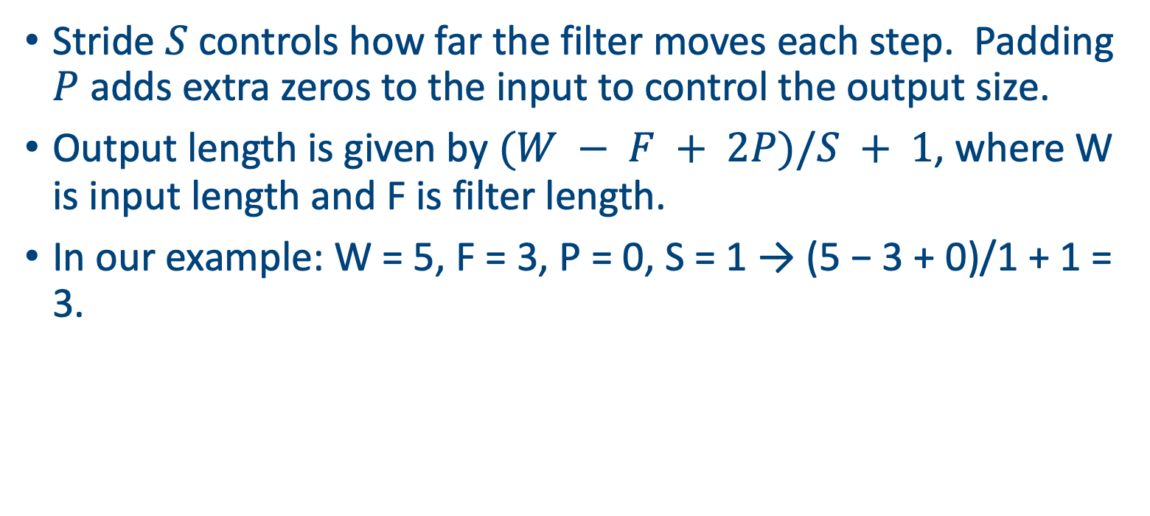
Stride and padding
Stride $S$ controls how far the filter moves each step. Padding $P$ adds extra zeros to the input to control the output size.
Output length is given by $(W − F + 2P)/S + 1$, where W is input length and F is filter length.
In our example: W = 5, F = 3, P = 0, S = 1 → (5 − 3 + 0)/1 + 1 = 3.
Example padded input
0
2
0
3
1
-1
0

Slide 16
1D convolution summary
Locality: filters look at neighbouring elements instead of the entire input.
Parameter sharing: one set of weights is reused across the input, reducing parameters.
Stride & padding control the output length and allow downsampling.
The same ideas extend naturally to higher‑dimensional inputs (2D, 3D, etc.).
Pooling layers (next slide) reduce the dimension still further

Slide 17
Another layer type: pooling
Pooling down-samples feature maps, summarising local patches and reducing spatial resolution.
Two common types are max pooling (take the maximum) and average pooling (take the mean).
Pooling introduces translational invariance by discarding precise positional information.
Input
2
1
3
2
Max pooled
0
4
5
1
4
5
1
2
0
3
2
3
2
1
2
0

Slide 18
Next: 2D convolutions
Input
In 2D convolutions, a filter (kernel) slides over height and width of an input image or feature map.
Each filter has dimensions H×W×D, where D equals the number of input channels. Convolution produces one feature map per filter.
Multiple filters are stacked to produce multiple feature maps. The output spatial size depends on the filter size, stride and padding.
1
2
1
0
-1
0
2
1
1
Kernel
1
0
0
-1

Slide 19
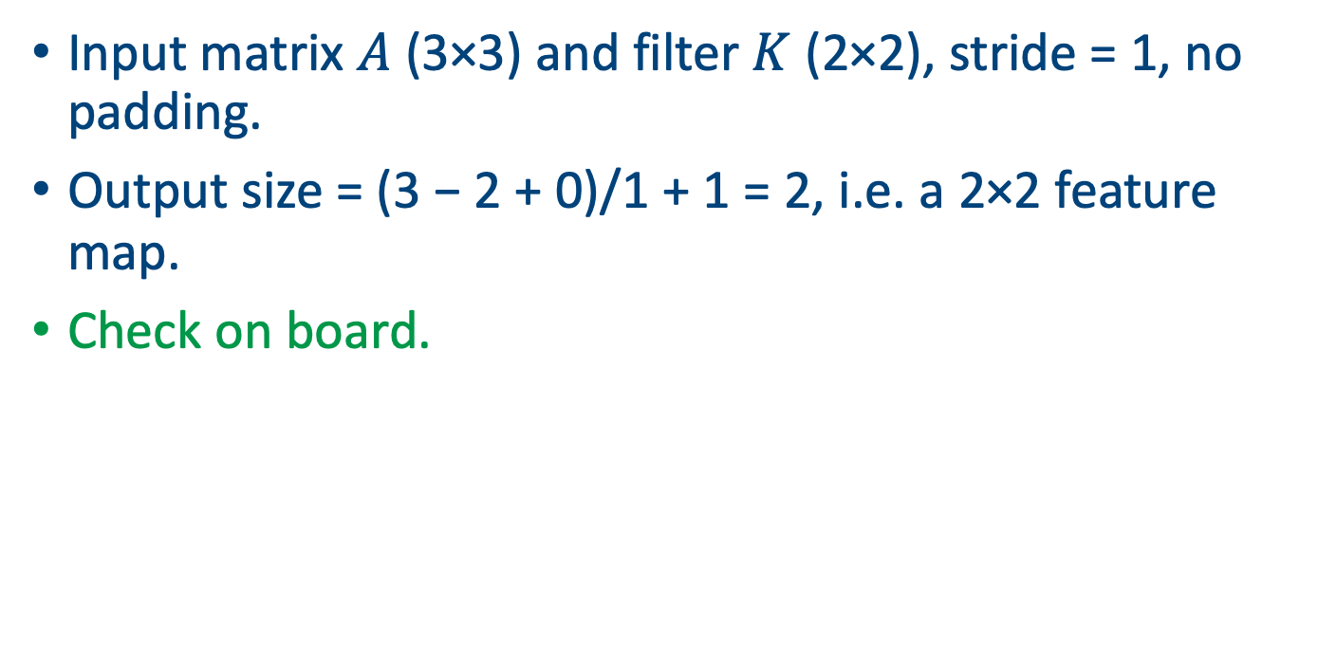
2D convolution example
Input matrix $A$ (3×3) and filter $K$ (2×2), stride = 1, no padding.
Output size = (3 − 2 + 0)/1 + 1 = 2, i.e. a 2×2 feature map.
Check on board.
A
K
Output
1
2
1
1
0
2
2
0
-1
0
0
-1
-1
2
2
1
1

Slide 20
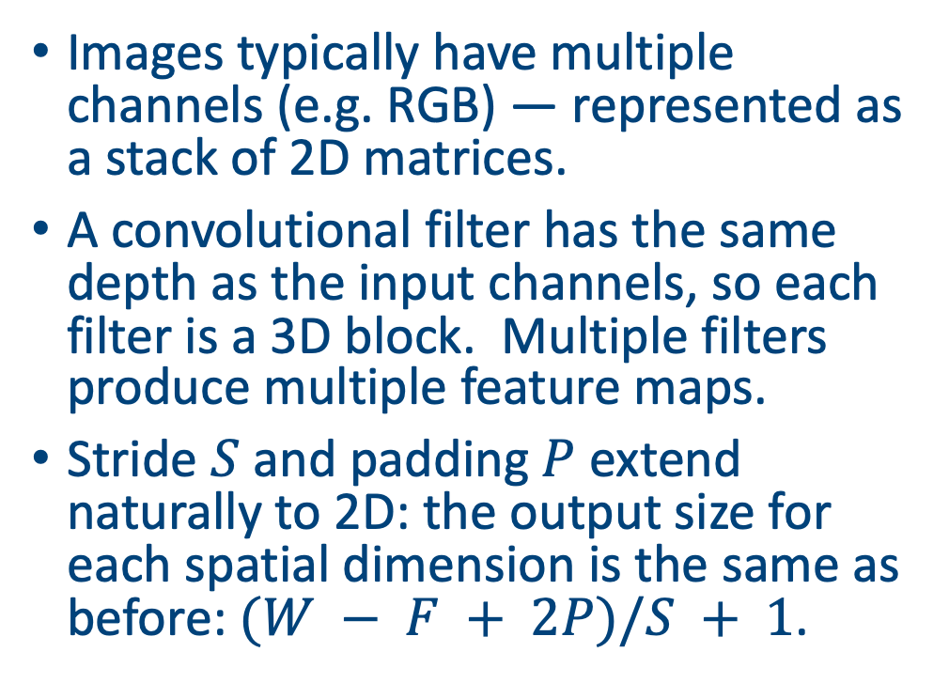
Channels and filters
Input channels
Images typically have multiple channels (e.g. RGB) — represented as a stack of 2D matrices.
A convolutional filter has the same depth as the input channels, so each filter is a 3D block. Multiple filters produce multiple feature maps.
Stride $S$ and padding $P$ extend naturally to 2D: the output size for each spatial dimension is the same as before: $(W − F + 2P)/S + 1$.
Filter
Feature map

Slide 21
Building a CNN
A basic CNN stacks layers in a chosen order, e.g. convolution → activation → pooling → fully connected.
Convolution and pooling reduce spatial dimensions while increasing depth. After flattening, a dense layer classifies features.
The figure on the right tracks the shape of an example input (8×8) through the network.
Any model with enough layers becomes a deep learning NN
8×8 input
Conv, ReLU & pool
Flatten
Dense→output

Slide 22
Feature hierarchies
Convolutional networks learn hierarchical features:
Early layers detect simple edges and textures.
Intermediate layers combine edges into motifs (e.g. corners, curves).
Deeper layers capture high‑level parts and objects.
Illustrated on the right are abstract patterns representing different levels of abstraction.
Edges
Motifs
Objects

Slide 23
Stitching ideas together
Dropout: mitigates over‑fitting by randomly deactivating units.
Weight decay (also known L2 regularisation or dilution): penalises large weights to encourage smoother models.
Data augmentation: synthetically enlarge datasets by random cropping, flipping, scaling.
Mini‑batch training & optimisation: stochastic gradient descent (SGD) with Adam optimiser improves convergence.
Early stopping: monitor validation loss and stop training when performance no longer improves.

Slide 24
Some cool NN variants
Activation variants: Leaky ReLU allows a small gradient for negative inputs; ELU and SELU reduce vanishing gradients; Softmax maps outputs to a probability distribution for classification.
Normalisation variants: Layer norm normalises across features within one example; Group norm normalises within groups of channels; Instance norm for style transfer tasks.
Dropout variants: Spatial dropout drops entire feature maps; Shake‑Drop perturbs activations stochastically.

Slide 25
Pooling variants
Average pooling: computes the mean of each patch, reducing noise.
Global average pooling: replaces the fully connected layer by averaging over the entire spatial dimension per channel.
Strided convolution: downsampling can also be achieved by using a stride > 1 instead of separate pooling layers.
Adaptive pooling: output size is specified instead of window size, automatically choosing kernel size and stride.

Slide 26
A technical aside
Convolution can be reinterpreted as a matrix multiplication by unrolling the input into patches (im2col) and flattening the filter.
This representation allows us to leverage highly optimised matrix multiplication routines (e.g. BLAS) but at the cost of increased memory.
Illustration: 2×2 filter applied to a 3×3 input yields a Toeplitz matrix of size 4×9 multiplied by the flattened filter vector.
Illustration on board

Slide 27
Implementation in Pytorch
Vectorised code is critical for efficient deep learning. Use established frameworks (e.g. PyTorch) that implement convolutions with GPU acceleration.
import torch.nn as nn
class SimpleCNN(nn.Module):
def __init__(self):
super().__init__()
self.conv1 = nn.Conv2d(in_channels=1, out_channels=8, kernel_size=3)
self.pool = nn.MaxPool2d(kernel_size=2, stride=2)
self.fc1 = nn.Linear(8 * 3 * 3, 10)
def forward(self, x):
x = nn.functional.relu(self.conv1(x))
x = self.pool(x)
x = x.view(x.size(0), -1)
x = self.fc1(x)
return x

Slide 28
Common CNN architectures
LeNet (1998): early handwritten digit recogniser; 5×5 filters, tanh activations.
AlexNet (2012): deeper nets with ReLU, dropout and 3×3 / 11×11 conv layers; won ImageNet competition.
VGG (2014): very deep (16–19 layers) using only 3×3 convs and 2×2 pooling.
ResNet (2015): introduces skip connections to ease training very deep networks (up to hundreds of layers).
Notes:
Skip connections (also called residual connections) are links in a neural network that bypass one or more layers and feed the input of a layer directly into a later layer.
Instead of passing data strictly layer by layer in sequence, you "skip over" intermediate transformations and add (or sometimes concatenate) the earlier signal to the later output.
Why are they used?
Solve vanishing gradient problem By providing a shorter path for gradients during backpropagation, skip connections help signals propagate more effectively in very deep networks.
Stabilize training They make optimization easier because the network can "choose" to learn the identity function (just pass information forward) if deeper transformations are not useful.
Improve accuracy They allow the model to combine both low-level and high-level features, which is especially useful in computer vision and sequence models.

Slide 29
Summary
Dense networks connect everything, but convolutions exploit locality and sharing to scale to high‑dimensional inputs.
Layer types such as dropout, batch norm, activations and pooling enable training deeper networks, stabilise learning and improve generalisation.
Convolution extends naturally to 2D inputs with multi‑channel filters; stride and padding control output shapes.
Building blocks combine to form deep CNNs capable of recognising complex patterns in images, speech and beyond.
Continuous innovation (activations, normalization, architectures) and regularisation are key to advancing the state of the art.

Slide 30
Next class
Run through D2C3_code.ipynb

Slide 31
Afternoon session instructions
Use some of the data sets in the data directory (or download your own)
Pick a variable and get an LLM to help you write a deep learning model with convolutional layers in Pytorch to predict a response variable from some covariates
(Advanced: try to find some satellite images of Ireland (Lough Neigh?) over time and see if you can see changes in the colours
Present your ipynb file in 5 minutes

